Slide 1


Coral reefs: apex predator paradise or mesopredator nirvana?
MR Heupel, DM Knip, CA Simpfendorfer, NK Dulvy

Slide 2
The issue
Loss of top predators is a common symptom of exploitation in both marine and terrestrial systems
Exploitation of aquatic systems is leading to alterations to ecosystems including trophic cascades
Understanding the functional role of predators is crucial to defining the efficacy of management and conservation and defining the implications of environmental change

Slide 3
Functional roles
The functional role of a predator is key to defining its impact
Definition of the role of predator species in terms of interaction strength and redundancy is required to understand the consequences of their removal or depletion within the system
For example: is predation acute or diffuse?

Slide 4
Definitions – apex predator
Apex predator: species that occupy the top trophic position in a community (Ritchie & Johnson 2009)
In terrestrial systems apex predators are noted to:
  1) often have strong effects on trophic dynamics and diversity of systems
  2) affect abundance of mesopredators via lethal encounters or influencing behaviour
  3) kill smaller predators for food and to avoid competition
  4) suppress mesopredators through fear and dominance
Ritchie & Johnson 2009. Ecology Letters 12: 982-998

Slide 5
Definitions - mesopredator
Mesopredator: encompasses any mid-ranking predator in a food web regardless of size or taxonomy that occupies trophic positions below apex predators (Prugh et al. 2009, Ritchie & Johnson 2009)
Mesopredators:
  1) should be better at exploiting shared food resources
  2) are less specialised hunters than apex predators
  3) have less influence on the behaviour of other species
However, the definition of mesopredators can be context-specific.
Prugh et al. 2009. BioScience 59: 779-791
Ritchie & Johnson 2009. Ecology Letters 12: 982-998

Slide 6
Role of sharks as predators
Not all (or most) sharks function as apex predators
Many systems will be comprised of a suite of sharks functioning as mesopredators (diffuse predation) with no individual species exerting overarching top down pressure
Truly apex species will exert acute predation and dominance effects, although their presence is often transient

Slide 7
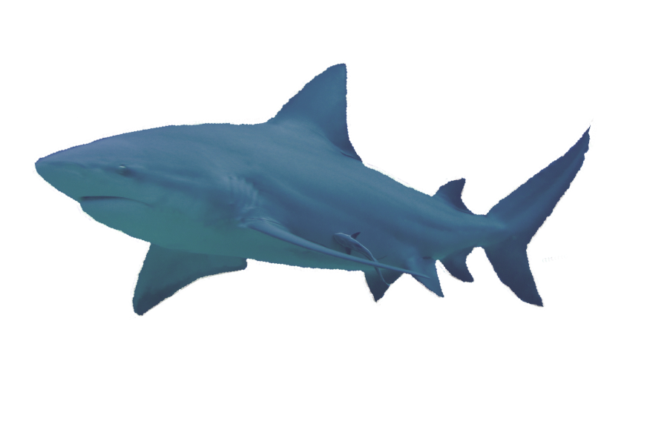
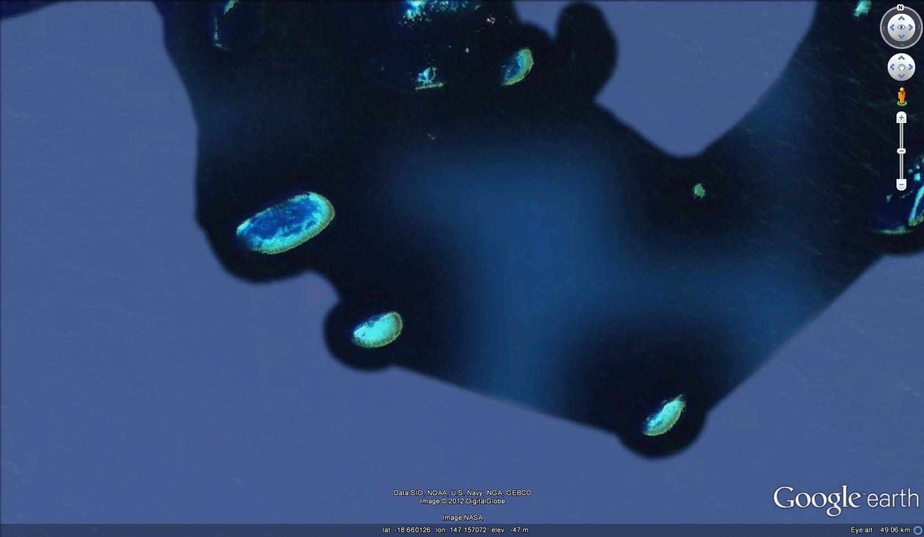

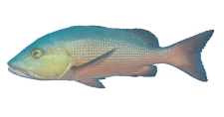
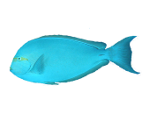
Resident and transient predator interactions
Mesopredator
Apex predator

Slide 8
The role of MPAs
MPAs are a common approach used to manage coral reef and coastal ecosystems
Spatial management is likely to provide high protection for resident species but not broad ranging species (ie apex predators)
Despite MPA protection, apex predators are likely being removed by multiple fisheries as they move throughout their extensive range
Lack of MPA protection for apex species may not be apparent in resulting ecosystem responses because mesopredators are still seen at high levels

Slide 9
No MPA: predator loss
apex predators
Reduction due to fishing
Prey species increase resulting from loss of apex and mesopredators
prey species
mesopredators

Slide 10
Reef scale MPA: mesopredator release
Reduction due to fishing
apex predators
Mesopredators increase resulting from protection from fishing coupled with loss of apex predators
prey species
mesopredators

Slide 11
MPA and fishery implications
Due to their wide-ranging nature apex predators are more likely to be depleted than other predators
Reef scale MPAs are likely to protect mesopredators, but provide limited shelter for apex predators
Mesopredator release may be occurring in coral reef systems where MPAs are in place to shelter these populations of diffuse predators
Are humans really the apex predator in these systems?

Slide 12
Ecosystem implications
A mesopredator driven system results in predator redundancy, thus loss of a single mesopredator species may be of little effect because predation will still occur through persistence of additional mesopredators in the system
Loss of an apex predator species may have broader effects due to loss of acute predation, loss of dominance effects and lack of a conspecific apex predator to fill this role
Protection of shark populations needs to consider functional roles of predator species to ensure adequate conservation and management

Slide 13
Apex predator paradise or mesopredator nirvana?
With MPAs in place: mesopredator nirvana
Without MPAs in place: neither
Apex predators continue to be exploited in both scenarios and their role in reef systems and fate in our oceans requires greater attention

Slide 14

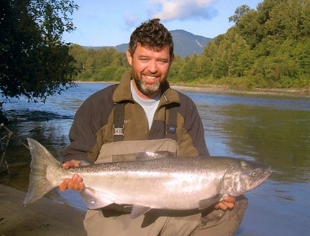

Thanks
This work was funded in part by The Australian Research Council, Australian Institute of Marine Science, James Cook University and Simon Fraser University
The authors would like to thank all the colleagues we discussed these concepts with
Thanks to my co-authors

